Slide 1


Individual-based modelling in RangeShiftR
Damaris Zurell, Anne Malchow
https://damariszurell.github.io
@ZurellLab
Pictures from www.undekade-biologischevielfalt.de
Notes:
1

Slide 2
Ecology is hierarchical
Hierarchy of organisational levels from genes to ecosystems
Each level operates and evolves on a characteristic spatial and temporal scale
It is crucial to find the appropriate modelling level for the given ecological problem or application

Slide 3
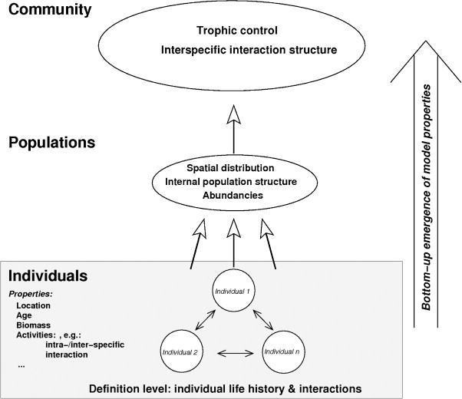
Emerging population dynamics
“The whole is more than the sum of its parts.” – Aristotle
Bottom-up approach: use knowledge about behaviour of single individuals to infer properties of the larger population or community
Reuter, et al. (2010) Basic Appl Ecol 11: 572-581.

Slide 4
Individual-based models (IBM)
Individuals/agents as unique discrete entity
Characterised by at least one state/property (additional to age) that changes through time
Allow to account for individual variability, local interactions, individual space use, behaviour …
Grimm (1999) Ecol Mod 115: 128-149.

Slide 5
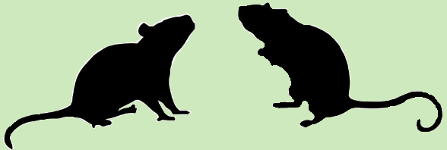

IBM state variables and processes
Growth rate, demographic structure, range dynamics, ...
Population
Environment
Space is represented as a regular 2D grid, where each cell is characterised by:
Habitat suitability index / Carrying capacity
Land cover proportions
Strength of abiotic drivers
Density-dependence
Individual
State: sex, age/stage, position, traits, genes, etc.
can vary among individuals and/or across time
Behaviour/Processes: reproduction, aging, maturing/developing, dispersal, mortality
can be dependent on current state and environment

Slide 6

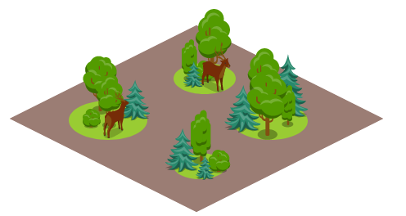
RangeShiftR
Simulating local population dynamics and dispersal
Local population dynamics described by population model, e.g. logistic growth or matrix population model
Dispersal described by dispersal kernel or movement simulator
Landscape can be described as patch-matrix landscapes, patch types of different quality, of grid cells of different quality

Slide 7
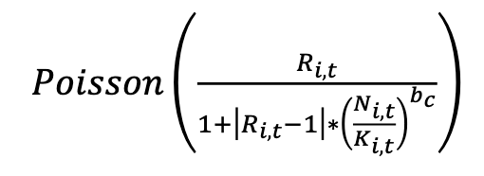
RangeShiftR – local population dynamics
Option 1: Non-overlapping generations and no stage structure
Discrete generations
In each generation life cycle: reproduction, death of adults, offspring dispersal
Described by discrete form of logistic growth
Important: individual-based formulation, meaning the number of offspring produced by adult is drawn from random distribution

Slide 8
RangeShiftR – local population dynamics
Option 2: overlapping generations and stage structure
Parameters provided through classical transition matrices (but applied stochastically)
Transition matrices can be age-structured (Leslie matrix) or stage-structured (Lefkovitch matrix)
Life-cycle graph:
Stages:
Juveniles / first-year birds do not breed
Second-year birds are inexperienced breeders
Mature adults are experience breeders
Transition rates:
F_{i,1} Fecundity
S_{i,j} Development rate (transition to next stage)
S_{i,i} Survival probability
With (2019) Oxford Univ. Press.
Notes:
2

Slide 9
RangeShiftR – local population dynamics
Option 2: overlapping generations and stage structure
Parameters provided through classical transition matrices (but applied stochastically)
Transition matrices can be age-structured (Leslie matrix) or stage-structured (Lefkovitch matrix)
Life-cycle graph:
(Lefkovitch) Transition matrix:
Fecundity
Survival
Development
With (2019) Oxford Univ. Press.
Notes:
2

Slide 10
Dispersal
Natal/juvenile dispersal: spatial process by which individuals move away from birth location
avoid kin competition, exploit new resources
Critical for range expansion and spatial gene flow
Associated with various costs and trade-offs that determine the eventual displacement distance
has impacts on both population dynamics and genetics

Slide 11
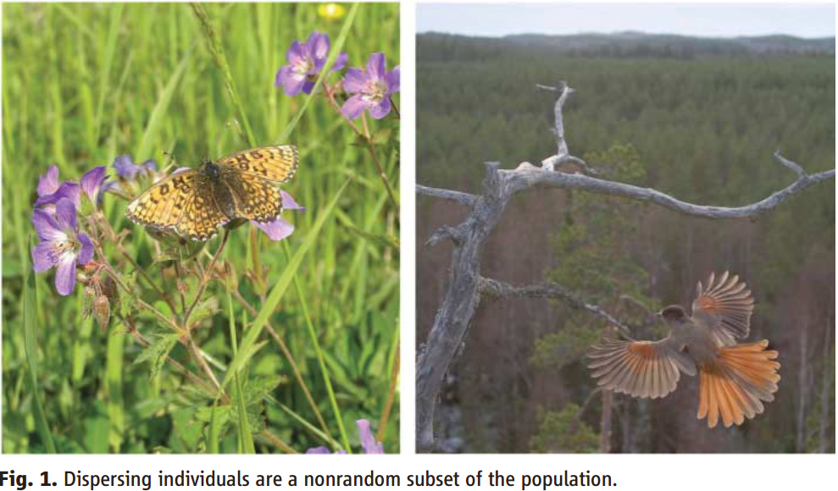
Dispersal
(Left) Dispersing females of the Glanville fritillary, Melitaea cinxia, have a higher flight metabolic rate and are more fecund than sedentary ones.
(Right) In Siberian jays, Perisoreus infaustus, the subordinate individuals disperse, whereas the heavier and more dominant remain in their natal territories.
Kokko & López-Sepulcre (2006) Science 313: 789-791.

Slide 12

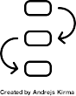

RangeShiftR: three phases of dispersal
Emigration
Leaving the natal site (area where born)
Transfer
Movement through the landscape
Settlement
Establish in a new habitat site /area

Slide 13
RangeShiftR: three phases of dispersal
Emigration
Leaving the natal site (area where born)
Transfer
Settlement

Slide 14
RangeShiftR: three phases of dispersal
Emigration probability:
the probability that an individual will leave its natal patch during the present year
can be density-dependent
Emigration
pEmig
Transfer
N
Settlement

Slide 15
RangeShiftR: three phases of dispersal
Emigration probability:
the probability that an individual will leave its natal patch during the present year
can be density-dependent
Emigration
D0 … saturation value
α … slope at inflection
β … inflection point
pEmig
~α
D0
Transfer
D0/2
βK
N
Settlement
stage | sex | D0 | α | β
0 | 0 | 0.4 | 10 | 1
0 | 1 | 0.9 | 10 | 1
... | ... | ... | ... | ...
sex = 0 … female
sex = 1 … male

Slide 16
RangeShiftR: three phases of dispersal
Emigration
Transfer
Movement through the landscape
Settlement

Slide 17
RangeShiftR: three phases of dispersal
Phenomenological models
Emigration
e.g. Dispersal Kernel
p
Transfer
distance
Settlement
Mechanistic models
e.g. Movement models:
step-wise processes that take perception and movement costs into account

Slide 18
RangeShiftR: mechanistic movement models
1.) Stochastic Movement Simulator
Movement costs
step-wise process
3
4
1
0
0
1
1
3
3
5
2
3
1
1
4
1
1
0
0
0
5
4
1
0
0
Habitat cell
Matrix cell

Slide 19

RangeShiftR: mechanistic movement models
1.) Stochastic Movement Simulator
Movement costs
step-wise process
takes perception into account
perceptual range (e.g. 1 cell)
3
4
1
0
0
1
1
3
3
5
2
3
1
4
1
1
0
0
0
5
4
1
0
0
Habitat cell
Current cell
Matrix cell
Perceptual area

Slide 20
RangeShiftR: mechanistic movement models
1.) Stochastic Movement Simulator
Movement costs
step-wise process
takes perception into account
perceptual range (e.g. 1 cell)
decision of next direction based on:
lowest average cost
preceeding steps in memory (e.g. 3 steps)
directional persistence
3
4
1
0
0
1
1
3
3
5
2
3
1
4
1
1
0
0
0
5
4
1
0
0
Habitat cell
Current cell
Matrix cell
Perceptual area

Slide 21
RangeShiftR: mechanistic movement models
1.) Stochastic Movement Simulator
Movement costs
step-wise process
takes perception into account
perceptual range (e.g. 1 cell)
decision of next direction based on:
lowest average cost
preceeding steps in memory (e.g. 3 steps)
directional persistence
3
4
1
0
0
1
3
3
5
2
3
3
1
4
1
1
0
0
0
5
4
1
0
0
Habitat cell
Current cell
Matrix cell
Perceptual area

Slide 22
RangeShiftR: mechanistic movement models
2.) Correlated Random Walk
no consideration of costs
step-wise process
considers continuous space, not grid cells
Habitat cell
Matrix cell

Slide 23
RangeShiftR: mechanistic movement models
2.) Correlated Random Walk
no consideration of costs
step-wise process
considers continuous space, not grid cells
draws direction from a distribution:
p
direction
of travel
direction
Habitat cell
Current cell
Matrix cell

Slide 24
RangeShiftR: three phases of dispersal
Emigration
Transfer
Settlement
Establish in a new habitat site /area

Slide 25
RangeShiftR: three phases of dispersal
Emigration
Transfer
Settlement
Settlement probability:
the probability that an individual will stay in a new habitat patch
can be density-dependent (analogous to emigration probability)

Slide 26
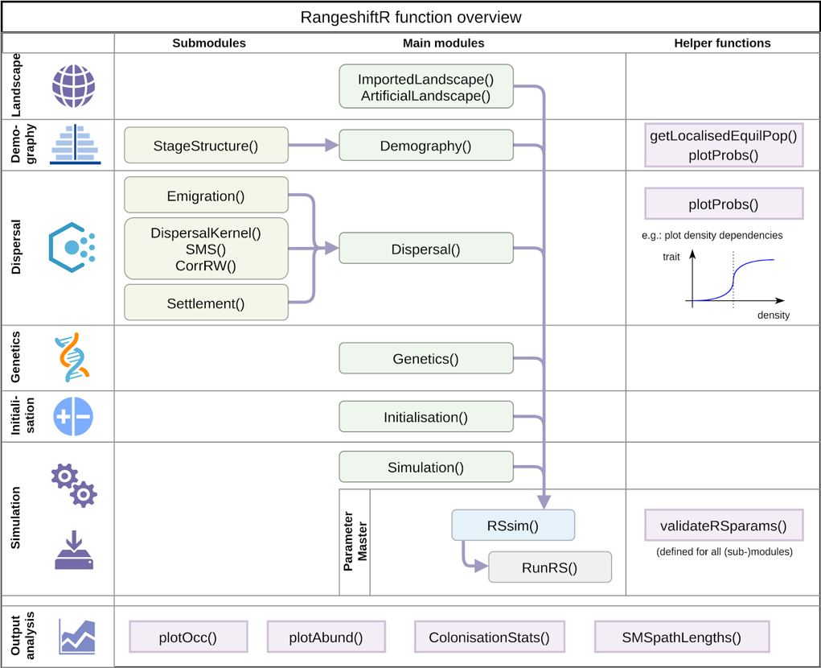

RangeShiftR overview
Malchow et al. (2021) Ecography. DOI: 10.1111/ecog.05689 .
Building on Bocedi et al. (2014) Methods Ecol Evol 5: 388-396. & Bocedi et al. (2021) Ecography. DOI: 10.1111/ecog.05687.
Notes:
Open source
Flexibly to adapt to any species, system, or region
Facilitate model optimisation and comparison,
Integrate model validation and monitoring
Facilitate transparency and collaboration
Enable cost-effective design and evaluation of management solutions

Slide 27
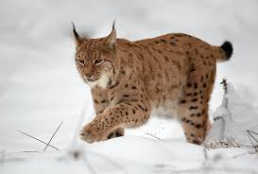
RangeShiftR case study
Example: Eurasian lynx, reintroduction Scotland
Stage-structured model, individual-based movement decisions
Aberdeenshire
Kintyre Peninsula
Keilder Forest
Ovenden et al. (2019) Biol Cons 234: 140-153.

Slide 28
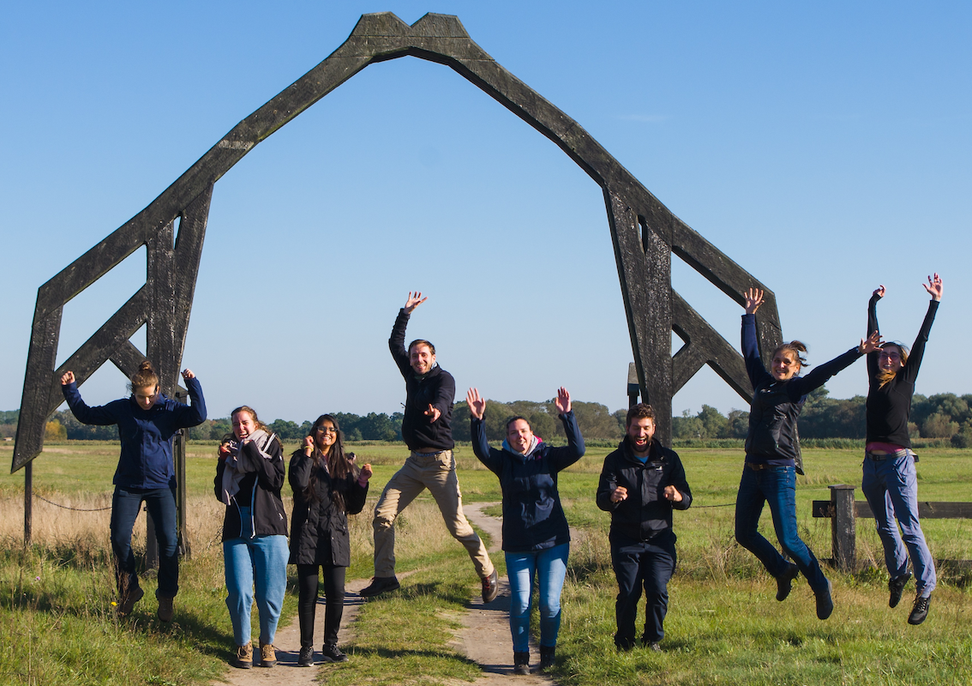

Thank you for your interest
Contact:
Damaris Zurell
Ecology & Macroecology
University of Potsdam
https://damariszurell.github.io
Email: damaris.zurell@uni-potsdam.de
@ZurellLab

